Slide 1

ngular for Architects
Data Patterns
Day 1
Dan Wahlin
John Papa

Slide 2
Get the Content
https://jpapa.me/afa-1
Notes:
Demos: https://github.com/DanWahlin/angular-architecture
Labs: https://codewithdan.me/ng-arch-1-day
Bonus NgRx Data Lab: https://github.com/johnpapa/ngrx-data-lab

Slide 3

John Papa
https://johnpapa.net
@John_Papa

Slide 4
Dan Wahlin
https://codewithdan.com
@DanWahlin

Slide 5
Agenda
Interfaces, Classes, and Types
Component View Models
HttpClient and RxJS Operators
RxJS Subjects
State Patterns
Observable Store
NgRx Data

Slide 6
Slides https://jpapa.me/afa-1
Lab - Tooling and Setup
Install tooling
Get the samples and lab code
Make sure it all works
https://codewithdan.me/angular-arc-labs
Notes:
https://jpapa.me/aaseries
Node version managers
macOS and WIndows https://github.com/nvm-sh/nvm
macOS only https://github.com/tj/n
https://update.angular.io/

Slide 7
Interfaces, Classes, and Types

Slide 8

The Role of Types
https://codewithdan.me/ng-interfaces-types

Slide 9


Interfaces and Classes
Interface
Define the "shape" of data
Class
Create an instance

Slide 10
What Do They Generate?
Interface
Nothing!!!
interface Customer {
name: string;
address: string
}
Generates
"use strict";
var Person = /** @class */ (function () {
function Person() {
}
return Person;
}());
ES5
class Customer {
name: string;
address: string;
}
Class
Generates

Slide 11
Interfaces versus Classes
Interfaces
Classes
Zero impact on bundle size
Define the "shape" of data
Supports optional members
0 calories, tastes great!
Full intellisense/code help
Type parameters, properties, and more
Impact bundle size
Used to create new instances
Store data and provide runtime functionality
More calories, tastes great!
Full intellisense/code help
Type parameters, properties, and more

Slide 12
Class Usage Scenarios
Create a Type
Store Data & Functionality
export class Customer {
id: number;
name: string;
address: string;
…
}
export class Order {
id: number;
productId: number;
quantity: number;
…
}
class CartOrder { customer: Customer;
order: Order;
init() {
this.customer = new Customer(...);
this.order = new Order(...);
}
}
let model = new CartOrder();
// store data/call functions

Slide 13
Usage Scenario: Type a Property
Interface
Type a Property
export interface Customer {
id: number;
name: string;
address: string;
}
export interface Order {
id: number;
productId: number;
quantity: number;
}
class MyClass { customer: Customer;
order: Order;
…
}

Slide 14
Usage Scenario: Type a Parameter/Return Value
Interface
Type a Parameter or Return Value
export interface Customer {
…
}
export interface Order {
…
}
export interface OrderStatus {
transactionId: string;
status: boolean;
}
class MyClass {
placeOrder(customer: Customer, order: Order) : Observable<OrderStatus> {
…
}
}

Slide 15
Usage Scenario: Drive Consistency
Interface
Drive Consistency
export interface CustomerInfo {
id: number;
name: string;
address: string;
address2?: string;
updateAddress(addr: string,
addr2?: string) : Observable<boolean>;
}
class Customer implements CustomerInfo { id: number;
name: string;
address: string;
updateAddress(addr: string,
addr2?: string) : Observable<boolean> {
…
}
}

Slide 16
Discussion: Interface Naming?
Is this Correct?
Or this?
export interface Customer {
id: number;
name: string;
address: string;
address2?: string;
updateAddress(addr: string,
addr2?: string) : Observable<boolean>;
}
export interface ICustomer {
id: number;
name: string;
address: string;
address2?: string;
updateAddress(addr: string,
addr2?: string) : Observable<boolean>;
}

Slide 17
There is no "correct way" to name interfaces. "Correct" is whatever your team collectively agrees to use and defines in their team style guide.

Slide 18
Usage Scenario: Type an Object Literal
Interface
Type an Object Literal
export interface Customer {
id: number;
name: string;
address: string
}
let customer: Customer;
…
customer = {
id: 424,
name: 'Jane Doe',
address: '1234 Main St.'
}; …
let myClass = new MyClass(customer);
class MyClass {
constructor(private customer: Customer) {}
}
Get full intellisense/code help
We know exactly what to pass!

Slide 19
Usage Scenario: Untyped Data
Untyped Data
getCustomers() {
return this.http.get(...);
}
…
customers$;
ngOnInit() {
this.customers$ = this.customersService.getCustomers();
}
What data structure are we working with here?

Slide 20
Usage Scenario: Typed Data
Interface
Typed Data
export interface Customer {
id: number;
name: string;
address: string
}
getCustomers() : Observable<Customer[]> {
return this.http.get<Customer[]>(...);
}
…
customers$: Observable<Customer[]>;
ngOnInit() {
this.customers$ = this.customersService.getCustomers();
}
We know exactly what we're getting back now!

Slide 21
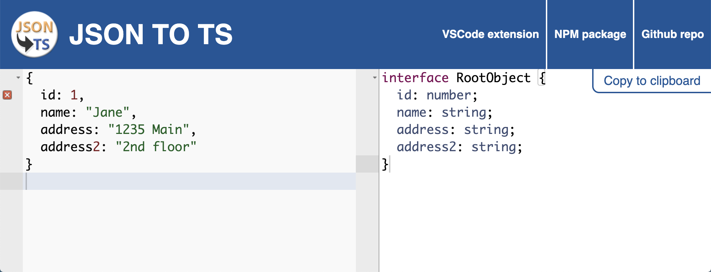
Converting JSON to an Interface
http://www.jsontots.com/

Slide 22
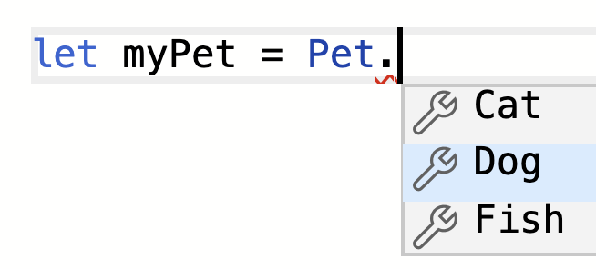
Working with Enums
Creating and Using an Enum
Output
enum Pet { Dog, Cat, Fish };
var Pet;
(function (Pet) {
Pet[Pet["Dog"] = 0] = "Dog";
Pet[Pet["Cat"] = 1] = "Cat";
Pet[Pet["Fish"] = 2] = "Fish";
})(Pet || (Pet = {}));
let myPet = Pet.Dog;
Generates

Slide 23
Enums Flexibility
Enums, Numbers, and Strings
enum Pet { Dog, Cat, Fish };
// Assigns a number
let myPet = Pet.Dog;
console.log(myPet); // 0
// Convert number to string
let petString = Pet[myPet];
console.log(petString); // "Dog"
// Convert string to number
let petNumber = Pet['Dog'];
console.log(petNumber); // 0

Slide 24
Using const Enums
Creating and Using an Enum
Output
const enum Pet { Dog, Cat, Fish };
let myPet = 0 /* Dog */;
Generates
No overhead or impact on bundle size!

Slide 25
Working with String Literal Types
Creating a String Literal Type
type Pet = 'dog' | 'cat' | 'fish';
let myPet: Pet;
…
myPet = 'dog';
myPet = 'bird'; // invalid
myPet = 'Cat'; // invalid

Slide 26
Using Readonly<T>
Interface
Using Readonly<T>
export interface Settings {
theme: string;
sidebar: string;
}
getUserSettings() : ReadOnly<Settings> {
return { theme: 'Dark', sidebar: 'left' };
}
…
init() {
// retrieve user settings
let settings = this.service.getUserSettings();
settings.theme = Theme.Dark;
}
Will error since settings has been marked as readonly

Slide 27
Using Partial<T>
Interface
Using Partial<T>
export interface Customer {
id: number;
name: string;
address: string
}
updateCustomer(cust: Partial<Customer>) : Observable<boolean> {
// perform update
return of(true);
}
…
Allow a portion of the Customer to be passed
Accept a partial Customer
submit() {
let cust: Partial<Customer> = { id: 1, name: 'John Doe' };
this.service.updateCustomer(cust);
}

Slide 28
Question:
What is the correct way to name interfaces?

Slide 29
Answer:
Name with consistency

Slide 30
Question:
Would you use an interface or a class if you need to create model instances?

Slide 31
Answer:
Classes

Slide 32
Question:
Someone asks you about Interfaces. What benefits would you tell them about?

Slide 33
Answer:
Can describe the "shape" of data for properties, parameters, custom types, and more
Can help drive consistency across classes
Zero calories, tastes great!
But...cannot be used to create instances

Slide 34
Component
View Models

Slide 35
Before we begin with View Models,
Let’s explore the challenges we will face without them.

Slide 36
Model-View Binding
1
Straight-forward binding a model to a View. Understanding the challenges with this approach.

Slide 37


Simple Model-View Binding
Two-way Data Binding
Model
View

Slide 38
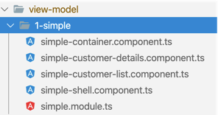
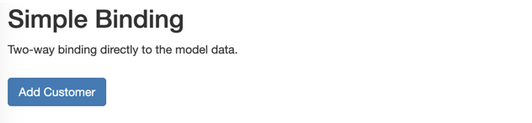

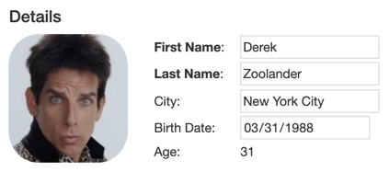
Demo 1: binding directly to the model
Shell
Container
Customer List
Customer Details

Slide 39

The Code Behind the Scenes

Slide 40
Container Class
customer.component.ts
export class SimpleContainerComponent {
customers$: Observable<Customer[]>;
selectedCustomer: Customer;
constructor(private dataService: CustomerOrdersDataService) {
this.customers$ = dataService.customers$;
}
selected(customer: Customer) {
this.selectedCustomer = customer; // <-- MODEL ENTITY
}
addCustomer() {
this.dataService.addCustomer();
}
}
The Customers Observable
Behind
the
Scenes

Slide 41
Container HTML
customer.component.html
<button (click)="addCustomer()">Add Customer</button>
<div *ngIf="customers$ | async as customers">
<div>
<app-customer-list [customers]="customers" (customerSelected)="selected($event)">
</app-customer-list>
</div>
<div>
<app-customer-details [customer]="selectedCustomer"></app-customer-details>
</div>
</div>
Binding to customers list
Binding to the selected customer
Behind
the
Scenes

Slide 42
Customer List Component
customer-list.component.ts
@Component({
template: `
<h4>Customers</h4>
...
<tr *ngFor="let customer of customers" (click)="selectCustomer(customer)">
<td>{{ customer | fullname }}</td>
</tr>
`
})
export class SimpleCustomerListComponent {
@Input() customers: Customer[];
@Output() customerSelected = new EventEmitter<Customer>();
selectCustomer(customer: Customer) { this.customerSelected.emit(customer); }
}
Custom pipe to compute first + last
Behind
the
Scenes

Slide 43
Customer Details Component
customer-detail.component.ts
@Component({
template: `
<h4>Details</h4>
...
<tr>
<td><img src="{{customer.photo}}"></td>
<td><b>First Name</b>: </td>
<td><input [(ngModel)]="customer.first"></td>
</tr>
... `
})
export class SimpleCustomerDetailsComponent {
@Input() customer: Customer;
}
Two way binding to customer
Behind
the
Scenes

Slide 44
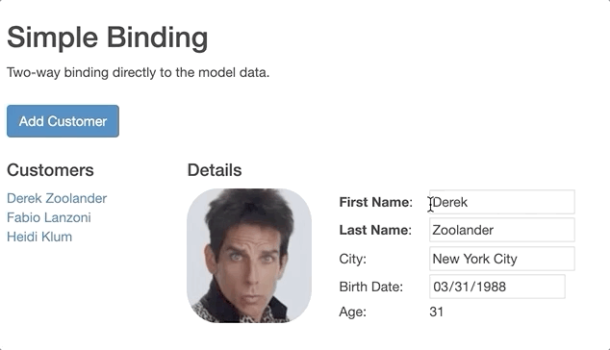
Model & view too tightly coupled
Customer List Component
Customer Detail Component
The customers list updates as we edit the details. This is not what we want.

Slide 45
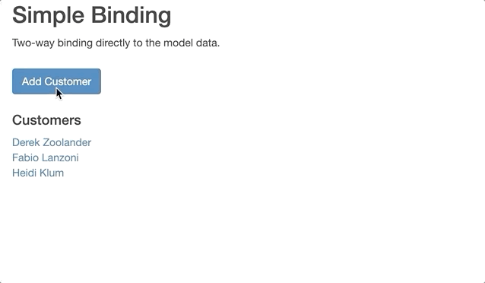
Model & view too tightly coupled
Adds to the customers list immediately.
Again, not what we want.

Slide 46
Question:
Why are the different components all getting the new and updated values at the same time?

Slide 47
Answer:
Both components are data-bound to the same model

Slide 48
The challenges ...
How do we bind multiple components to the same data?

Slide 49
Model-View Binding, with Cloning
2
Clone the model in the component. Then bind to the clone.

Slide 50
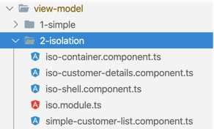
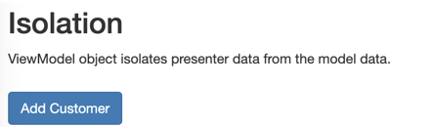
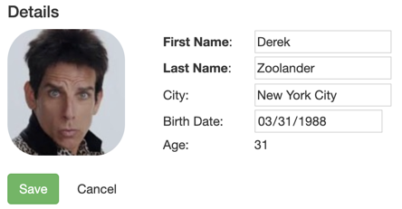
Demo 2: Isolate the changes with a clone
Shell
Container
Customer List
Customer Details

Slide 51
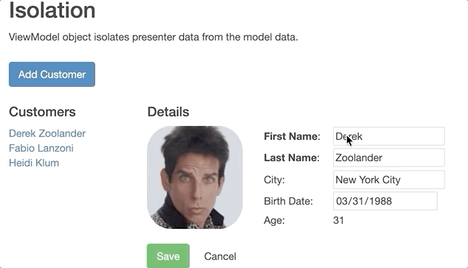
There is no update until save

Slide 52
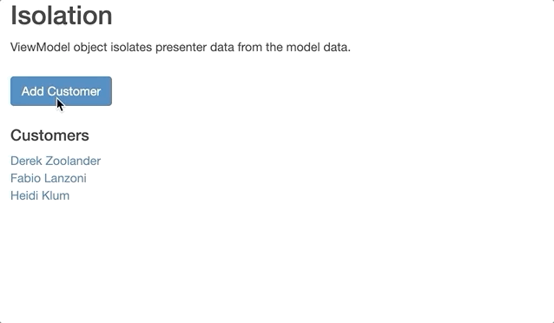
New items aren’t added until you save

Slide 53
Binding through a Clone is a ViewModel
Model
ViewModel
View

Slide 54
The container clones the customer
customer.component.ts
@Component({
template: `<app-customer-details [viewModel]="selectedCustomer"></app-customer-details>`
})
export class ContainerComponent {
selected(customer: Customer) {
this.selectedCustomer = { ...customer };
}
addCustomer() {
this.selectedCustomer = {
photo: 'assets/missing-person.png'
};
}
}
Shallow clone with the spread operator
Any object can be a View Model

Slide 55
Bind to the clone in Customer Details
customer-detail.component.ts
@Component({
template: `
<td><img src="{{ vm.photo }}" /></td>
<td>First Name: <input [(ngModel)]="vm.first" /></td>
<button (click)="save.emit(vm)">Save</button>
`
})
export class CustomerDetailsComponent {
@Input() vm: Customer;
@Output() save = new EventEmitter();
get saveDisabled() { return !this.vm.first || !this.vm.last; }
}
vm is the conventional abbreviation for ViewModel

Slide 56
Send the ViewModel to be Saved
customer-detail.component.ts
save(viewModel: Customer) {
this.selectedCustomer = null;
customer.id == null
? this.dataService.addCustomer(viewModel)
: this.dataService.updateCustomer(viewModel);
}

Slide 57
Question:
How would a ViewModel clone help with canceling?

Slide 58
Answer:
When a user cancels editing a ViewModel clone, there is no impact on the List component.

Slide 59
Clone ViewModel Benefits
Customer is unchanged in other views until the save
Customer is added to list only after the save
Easy to cancel
Easier validation (ex: Save button disabled without name)

Slide 60
The challenges ...
You’re still tightly coupled to the model as you’re limited to its properties
Presentation properties would be nice so you can get rid of pipes and transformations

Slide 61
ViewModel Class
3
Move the model to a ViewModel, in it’s own class. Hide properties, add new properties, change the shape of the model.

Slide 62
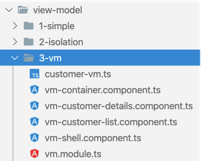
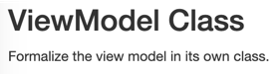
Demo 3: View Model Class
Shell
Container
Customer List
Customer Details

Slide 63

Binding through a ViewModel CLASS
Model
ViewModel
View

Slide 64
Model has more than we want
Can we hide properties?
customer.ts
export interface Customer {
id: number;
first: string;
last: string;
city = '';
birthDate?: Date;
photo?: string;
isDeleted?: boolean;
pet?: string;
}
ViewModel won’t need these

Slide 65
The ViewModel class adapts
The ViewModel class adapts the model to meet the needs of the views.
customer-viewmodel.ts
export class CustomerVm {
id: number;
first: string;
last: string;
city: string;
birthDate?: Date;
photo: string;
get age() { return calcAge(this.birthDate); }
get name() { return calcFullName(this); }
get saveDisabled() { return !this.first || !this.last; }
}
Only include properties the View needs
Add methods and properties to keep code and pipes out of the HTML

Slide 66
ViewModel class
customer-viewmodel.ts - creation methods
Partial: contain a subset of Customer
static create(customer: Partial<Customer>): CustomerVm {
return Object.assign(new CustomerVm(), toCustomer(customer));
}
clone() {
return Object.assign(new CustomerVm(), this);
}
toCustomer() {
const vm = this;
const { id = null, first = '', last = '', city = '' } = vm;
return { id, first, last, city };
}
Clone itself
Return a customer-like object that can be saved.
Missing properties get default values

Slide 67
Bind to the ViewModel in Customers List
customer-list.component.html
<h4>Customers</h4>
<table>
<tr *ngFor="let vm of vms" (click)="select(vm)">
<td>{{ vm.name }}</td>
</tr>
</table>
ViewModel name property calculates first + last.
There is no need for custom FullNamePipe.

Slide 68
Question:
What would motivate you to create a ViewModel class over a simpler ViewModel clone?

Slide 69
Answer:
A ViewModel class can add or hide properties of the model.

Slide 70
The challenges ...
What about complex, connected models?

Slide 71
Complex Data with ViewModels
4
ViewModels can contain object graphs.
Use View Services to contain all logic for manipulating the ViewModel.

Slide 72
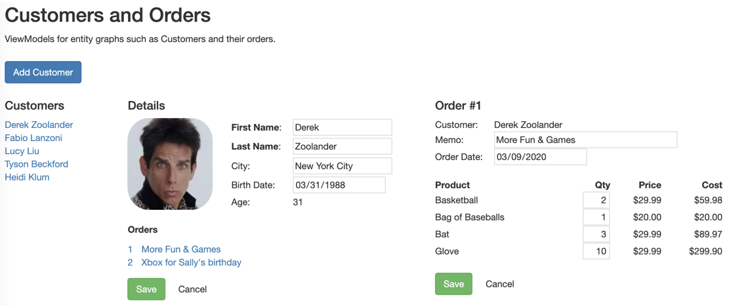
Demo 4: Customers & Orders

Slide 73
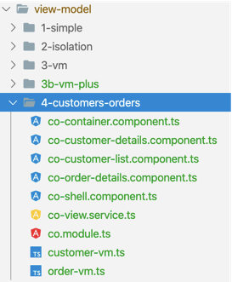
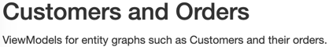
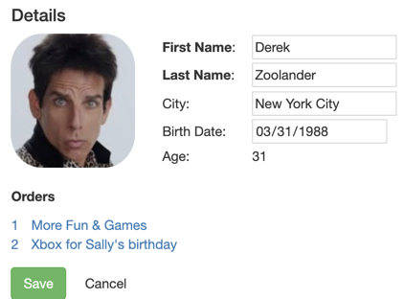
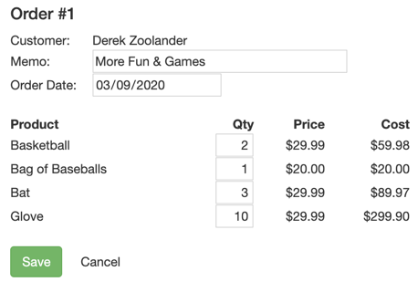
Demo 4: Customers & Orders
Shell
Container
Customer List
Customer Details
Order Details

Slide 74
ViewModel of the customer graph
Customers
Customer #1
Customer #1
Customer #2
Orders
Order
Customer #3
Order
Customer #2
LineItems
Order
Order
Customer #3
Customer #3
Products
Order
Order
Model
ViewModels
Views

Slide 75
ViewService builds complex ViewModels
When data sources are complex and interconnected,
assemble ViewModels with a service dedicated to the cooperating views
customer-order.view-service.ts
export class CustomersOrdersViewService {
}
View Service coordinates VMs for the Views
customerVms$: Observable<CustomerVm[]>;
constructor(dataService: CustomerOrdersDataService) {}
addCustomer() {}
createCustomerVms$(): Observable<CustomerVm[]> {)
saveCustomer(customerVm: CustomerVm) {}
saveOrder(orderVm: OrderVm) {}
selectedOrderVm(orderId: number, customerVm: CustomerVm) {}
Notes:
View Service coordinates the VMs for the Views

Slide 76
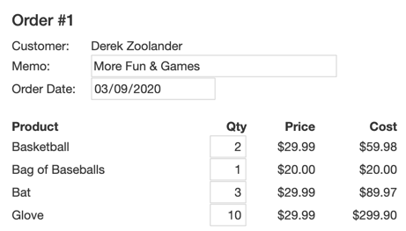
Order ViewModel
export interface OrderVm {
orderId: number;
customerName: string;
memo: string;
orderDate: Date;
lineItems: LineItemVm[];
}
Order
LI
P
LI
P
LI
P
LI
P
export interface LineItemVm {
id: number;
productId: number;
productName: string;
price: number;
quantity: number;
}

Slide 77
customer-order.view-service.ts
Build the Order ViewModel in the View Service
export function createVm(customer: { first: string, last: string }, graph: OrderGraph): OrderVm {
const { order, lineItems, products } = graph;
}
Join line items and their products into LineItem ViewModels
const lineItemVms = lineItems.map(item => {
const { productName, price } = products[item.productId];
const {id, productId, quantity } = item;
return { id, productId, productName, price, quantity } as LineItemVm;
});
const {id, memo, orderDate} = order;
return {
id,
customerName: calcFullName(customer),
memo,
orderDate,
lineItems: lineItemVms
} as OrderVm;
Merge selected order properties with the LineItem ViewModels array
Notes:
View Service:
Build the Order ViewModel in the view service

Slide 78
Container component stays clean for customers and orders
customerVms$: Observable<CustomerVm[]>;
selectedCustomerVm: CustomerVm;
selectedOrderVm$: Observable<OrderVm>;
constructor(private viewService) { this.customerVms$ = viewService.customerVms$;
}
saveCustomer(customerVm: CustomerVm) {
this.selectedCustomerVm = null;
this.selectedOrderVm$ = null;
this.viewService.saveCustomer(customerVm);
}
selectCustomer(vm: CustomerVm) {
this.selectedCustomerVm = vm.clone();
this.cancelOrder();
}
saveOrder(orderVm: OrderVm) {
this.selectedOrderVm$ = null;
this.viewService.saveOrder(orderVm);
}
Notes:
container component stays clean

Slide 79
Clean views too
order-detail.component.ts
export class OrderDetailsComponent {
@Input() vm: OrderVm;
@Output() cancel = new EventEmitter();
@Output() save = new EventEmitter();
}
customer-list.component.ts
export class CustomerListComponent {
@Input() vms: CustomerVm[];
@Output() selected = new EventEmitter<CustomerVm>();
select(vm: CustomerVm) { this.selected.emit(vm); }
}
customer-detail.component.ts
export class CustomerDetailsComponent {
@Input() vm: CustomerVm;
@Output() cancel = new EventEmitter();
@Output() save = new EventEmitter();
@Output() selectOrder = new EventEmitter();
}

Slide 80
Question:
What are some pros and cons of using View Services?

Slide 81
Answer - Cons:
Yet another file
The complexity has moved
Overkill for simple ViewModels

Slide 82
Answer - Pros:
Hides assembly of complex ViewModels
Shares ViewModels with collaborating components
Easier to test than a component
Lets the Presenters focus on presenting
Keeps the Views and ViewModels clean

Slide 83
Questions:
When should you use ...
a ViewModel clone?
a ViewModel class?
a ViewModel with a ViewService?

Slide 84
Answers:
ViewModel clone | Simple. You just need an exact clone
ViewModel class | You need a clone but also to add/hide some properties
ViewModel with View Services | Your component represent several connected models

Slide 85
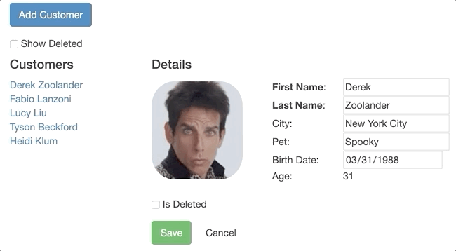
Slides https://jpapa.me/afa-1
Lab - Working with View Models
Visit the following URL and complete the Working with View Models lab.
https://codewithdan.me/angular-arc-labs

Slide 86
HttpClient and RxJS Operators

Slide 87
Key RxJS Operators with HttpClient
HttpClient and RxJS Operators
switchMap
concatMap
mergeMap
forkJoin
https://github.com/danwahlin/angular-architecture

Slide 88
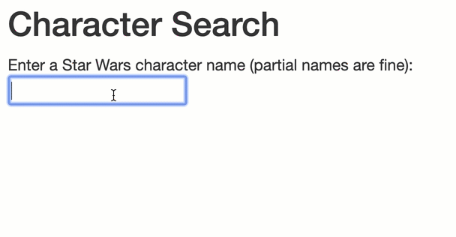
Understanding switchMap
HttpClient and RxJS Operators
Outer Observable
Inner Observable
(switch to new inner observable every time user data changes)

Slide 89
Using switchMap with AutoComplete
Switching to an Inner Observable as a User Types
Outer Observable
searchCharacters() {
this.searchCharacters = this.formGroup.get('characterName').valueChanges.pipe(
debounceTime(500),
switchMap(name => {
return this.dataService.getCharacter(name);
})
);
}
Wait for 500 milliseconds (to capture user input)
Switch to inner observable
(will unsubscribe from previous inner observable if new data is received from the outer observable)

Slide 90
Another Example of switchMap
Switching to an Inner Observable
getPeople() {
return this.http.get(this.baseUrl + 'people')
.pipe(
switchMap(res => {
// convert array to observable
return from(res['results']);
})
);
}
Outer Observable
Switch to new inner observable

Slide 91
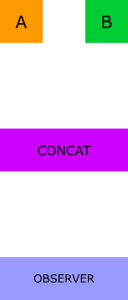
Understanding concatMap
HttpClient and RxJS Operators
https://codewithdan.me/rxjs-diagrams

Slide 92
Using concatMap
Concatenating Streams
getCharactersAndHomeworlds() {
return this.http.get(this.baseUrl + 'people')
.pipe(
switchMap(res => from(res['results'])),
concatMap((person: any) => {
return this.http.get(person['homeworld'])
.pipe(
map(hw => {
person['homeworld'] = hw;
return person;
})
);
}),
toArray()
);
}
Outer Observable
Switch to inner Observable array of people
Concat with inner observable
Update each person with their homeworld

Slide 93
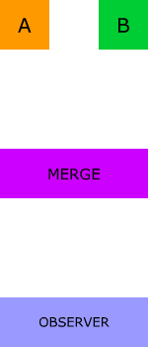
Understanding MergeMap
HttpClient and RxJS Operators
https://codewithdan.me/rxjs-diagrams

Slide 94
Using mergeMap
Merging Streams
getCharactersAndHomeworlds() {
return this.http.get(this.baseUrl + 'people')
.pipe(
switchMap(res => {
return from(res['results']);
}),
mergeMap((person: any) => {
return this.http.get(person['homeworld'])
.pipe(
map(hw => {
person['homeworld'] = hw;
return person;
})
);
}),
toArray()
);
}
Outer Observable
Switch to inner Observable array of people
Merge
Update each person with their homeworld

Slide 95
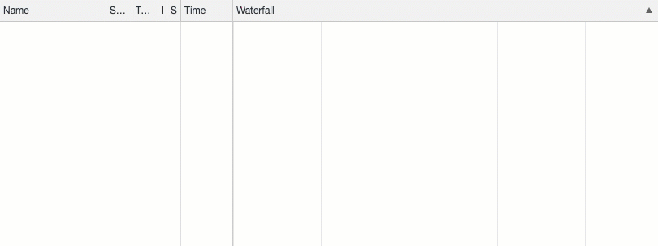
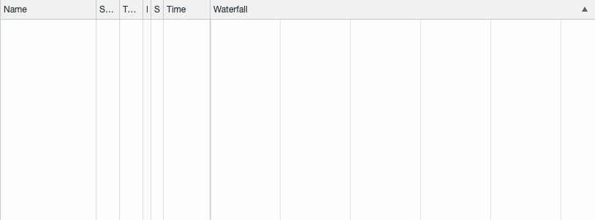
Comparing mergeMap and concatMap
mergeMap
Loaded in parallel
(order not maintained)
concatMap
Loaded in sequence
(order maintained)

Slide 96
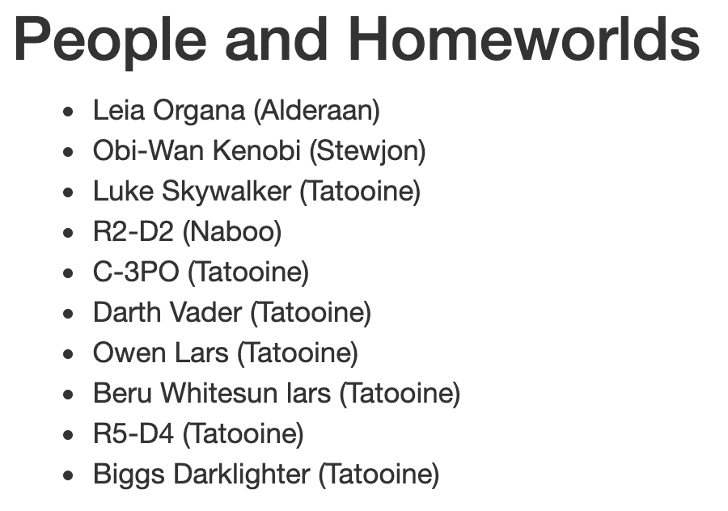
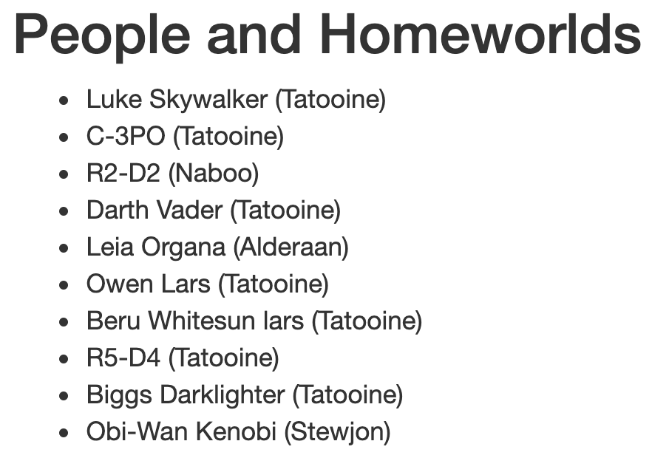
Comparing mergeMap and concatMap
mergeMap
Original order of people not maintained
concatMap
Original order of people is maintained

Slide 97
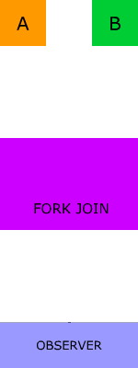
Understanding ForkJoin
HttpClient and RxJS Operators
https://codewithdan.me/rxjs-diagrams

Slide 98
Using forkJoin
Get the Last Emitted Value from Multiple Observables
getCharactersAndPlanets() {
return forkJoin(this.getCharacters(), this.getPlanets())
.pipe(
map((res) => {
return { characters: res[0], planets: res[1] };
}),
catchError(error => of(error))
);
}
Get last emitted value from each observable
Access the emitted value from each observable

Slide 99
Question:
Which operator will preserve the order of data received from multiple observables?

Slide 100
Answer:
concatMap

Slide 101
Question:
Which operator provides access to the last value emitted from multiple observables?

Slide 102
Answer:
forkJoin

Slide 103
Question:
Which operator provides a way to "switch" from an outer observable to an inner observable?

Slide 104
Answer:
switchMap

Slide 105
RxJS Subjects

Slide 106
Communication Options
Event Bus - Loosely coupled option (mediator pattern)
Notify components of changes in a service (using the observer pattern) with Subject/BehaviorSubject/ReplaySubject
AppComponent
NavBar
Component
EventBusService
Feature Component
Child Component

Slide 107
Creating an Event Bus
Event Bus - Loosely Coupled Communication (Mediator Pattern)
@Injectable({ providedIn: 'root' })
export class EventBusService {
private subject$ = new Subject();
on(event: Events, action: any): Subscription {
return this.subject$
.pipe(
filter((e: EmitEvent) => e.name === event),
map((e: EmitEvent) => e.value)
)
.subscribe(action);
}
emit(event: EmitEvent) { this.subject$.next(event); }
}
Notes:
Memoization - In computing, memoization or memoization is an optimization technique used primarily to speed up computer programs by storing the results of expensive function calls and returning the cached result when the same inputs occur again.
https://blog.mgechev.com/2017/11/12/faster-angular-applications-pure-pipes-memoization-pure-functions-part-2/

Slide 108
Raising an Event
Raise event by calling the event bus's emit() function
Pass an EmitEvent object with the event name and the event value
Using EventBusService to Emit an Event
export class CustomersListComponent implements OnInit {
constructor(private eventbus: EventBusService) { }
selectCustomer(cust: ICustomer) {
this.eventbus.emit(new EmitEvent(Events.CustomerSelected, cust));
}
}
Pass event name
(as a string or enum)
and value
Notes:
Memoization - In computing, memoization or memoization is an optimization technique used primarily to speed up computer programs by storing the results of expensive function calls and returning the cached result when the same inputs occur again.
https://blog.mgechev.com/2017/11/12/faster-angular-applications-pure-pipes-memoization-pure-functions-part-2/

Slide 109
Subscribing to an Event
Subscribe to an event by calling the on() function and passing the event name to subscribe to and the callback function
Using EventBusService to Subscribe to an Event
export class AppComponent implements OnInit, OnDestroy {
eventbusSub: Subscription;
customer: ICustomer;
constructor(private eventbus: EventBusService) { }
ngOnInit() {
//Use event bus to provide loosely coupled communication (mediator pattern)
this.eventbusSub = this.eventbus.on(Events.CustomerSelected, (cust => this.customer = cust));
}
ngOnDestroy() {
this.eventbusSub.unsubscribe();
}
}
Listen for specific event
Notes:
Memoization - In computing, memoization or memoization is an optimization technique used primarily to speed up computer programs by storing the results of expensive function calls and returning the cached result when the same inputs occur again.
https://blog.mgechev.com/2017/11/12/faster-angular-applications-pure-pipes-memoization-pure-functions-part-2/

Slide 110
Event Bus Pros and Cons
Pros
Cons
Simple to use - call emit() or on()
Loosely coupled communication
Lightweight
Who is triggering the event?
Loosely coupled events can make maintenance more challenging (due to above)
Must remember to unsubscribe

Slide 111
Observable Services
Send data to observers/subscribers
Follows the "observer pattern"
Provides a simple way to keep multiple observers (components, services) up-to-date
Service can use RxJS Subject objects and observables
You may have many customized observable services
Subject
Component
subscribe
Observable Service
data

Slide 112
RxJS Subjects
RxJS provides several “subjects” that can send data to observers
Subject
BehaviorSubject
ReplaySubject
AsyncSubject
Send data but any previously emitted data is not sent
Send last data value to observers as they subscribe
All previously sent data is also sent to new observers
Emits the last value (and only the last value) to observers when the sequence is completed
http://reactivex.io/documentation/subject.html
https://www.learnrxjs.io/
https://rxjs.dev/operator-decision-tree
https://rxjs-dev.firebaseapp.com/api

Slide 113


Slide 114
Creating an Observable Service
Using a Subject to Expose an Observable Object
@Injectable()
export class DataService {
customers: ICustomer[];
private customersSubject$ = new Subject<ICustomer[]>();
customersChanged$ = this.customersSubject$.asObservable();
addCustomer() : Observable<ICustomer[]> {
…
// Send customers data to any observers
this.customersSubject$.next(this.customers);
return of(this.customers);
}
}
Create a Subject and Observable
Send data to any observers
Notes:
Memoization - In computing, memoization or memoization is an optimization technique used primarily to speed up computer programs by storing the results of expensive function calls and returning the cached result when the same inputs occur again.
https://blog.mgechev.com/2017/11/12/faster-angular-applications-pure-pipes-memoization-pure-functions-part-2/

Slide 115
Using BehaviorSubject
Send an initial value to observers as they subscribe
@Injectable()
export class DataService {
private customers: ICustomer[];
private customersSubject$ = new
BehaviorSubject<ICustomer[]>(this.customers);
customersChanged$ = this.customersSubject$.asObservable();
addCustomer() : Observable<ICustomer[]> {
...
// Send customers data to any observers
this.customersSubject$.next(this.customers);
return of(this.customers);
}
}
Initial data to send to new observer
Send data to any observers
Notes:
Memoization - In computing, memoization or memoization is an optimization technique used primarily to speed up computer programs by storing the results of expensive function calls and returning the cached result when the same inputs occur again.
https://blog.mgechev.com/2017/11/12/faster-angular-applications-pure-pipes-memoization-pure-functions-part-2/

Slide 116
Subscribing to an Observable Service
Observers/consumers can access observable service data by subscribing
export class AppComponent implements OnInit {
customers: ICustomer[];
customersChanged$ = this.dataService.customersChanged$;
constructor(private dataService: DataService) { }
ngOnInit() {
//Example of using BehaviorSubject to be notified when a service changes
this.customersChanged$.subscribe(custs => this.customers = custs);
}
ngOnDestroy() {
this.customersChanged$.unsubscribe();
}
}
Subscribe to the observable
Notes:
Memoization - In computing, memoization or memoization is an optimization technique used primarily to speed up computer programs by storing the results of expensive function calls and returning the cached result when the same inputs occur again.
https://blog.mgechev.com/2017/11/12/faster-angular-applications-pure-pipes-memoization-pure-functions-part-2/

Slide 117
Observable Service Pros and Cons
Pros
Cons
Simple to use –subscribe/unsubscribe
Data source is known (simplifies maintenance)
Easy to share data between different layers of an application
Not as loosely coupled as an event bus (coupling between observable and observer)
Subject variations can be challenging to master
Must remember to unsubscribe

Slide 118
Using SubSink
https://github.com/wardbell/subsink
The SubSink package can simplify the cleanup of subscriptions
export class AppComponent implements OnInit, OnDestroy {
subs = new SubSink();
constructor(private eventbus: EventBusService, private dataService: DataService) { }
ngOnInit() {
//Use event bus to provide loosely coupled communication (mediator pattern)
this.subs.sink = this.eventbus.on(
Events.CustomerSelected, (cust => this.customer = cust)
);
}
ngOnDestroy() {
this.subs.unsubscribe();
}
}
Unsubscribe from all subscriptions in SinkSub

Slide 119
Question:
What type of Subject would you use if you wanted to only get values in the future?

Slide 120
Answer:
BehaviorSubject or ReplaySubject(1)

Slide 121
Slides https://codewithdan.me/ng-architecture-workshop
Walk-Through
Learn how an event bus can be used to communicate
Learn the role of different types of subjects in RxJS and how they can help with communication
Component Communication

Slide 122
Slides https://jpapa.me/afa-1
Lab - Creating an Observable Service
Create a service
Add a Subject and Observable
Subscribe to the Observable in a component
https://codewithdan.me/angular-arc-labs

Slide 123
State Patterns

Slide 124
State
Your apps have several forms of data. How do you manage each of these?

Slide 125
State Management
Service
Ngrx
Ngxs
Observable Store
Akita

Slide 126
Dependency Injection
Simplifies service acquisition
Simplifies testing (mock dependencies)
Inject services - don't "new" things up

Slide 127
Types of State
Entity State
Heroes, Villains, Customers, Orders, Stock Quotes
Session State
User info, preferences, app settings, UX state, router config
Local State

Slide 128
Angular Service
Simplest approach (start here!)
Inject service where needed
Provide notifications using Subject/BehaviorSubject/ReplaySubject
Component
Service
Component

Slide 129
Component
Component
Service
Service
Component
Component
Component
Service
Component
Component
Component
Service
Service
Component
Component

Slide 130
Problem
Proliferating services
Multiple copies of shared data
Inconsistent design and interaction patterns
Hard on teams

Slide 131
Service
Store
Service
Service

Slide 132
Observable Store
Simple yet effective state management solution

Slide 133

State Management Doesn't Have to be Hard!

Slide 134
Observable Store provides a simple way to manage state in a front-end application while achieving many of the key goals offered by more complex state management options.
https://github.com/DanWahlin/Observable-Store

Slide 135
Observable Store Goals
Single Source of Truth
Immutable State
State Change Notifications
Track State Change History
Simple to implement and maintain
Work with any front-end application

Slide 136

Observable Store - The Big Picture
CustomersService
Component
Observable Store
OrdersService
State
Component
InvoicesService

Slide 137
event-bus.service.ts
1
Install Observable Store
Notes:
Memoization - In computing, memoization or memoization is an optimization technique used primarily to speed up computer programs by storing the results of expensive function calls and returning the cached result when the same inputs occur again.
https://blog.mgechev.com/2017/11/12/faster-angular-applications-pure-pipes-memoization-pure-functions-part-2/

Slide 138
Install Observable Store
npm install @codewithdan/observable-store
Notes:
Memoization - In computing, memoization or memoization is an optimization technique used primarily to speed up computer programs by storing the results of expensive function calls and returning the cached result when the same inputs occur again.
https://blog.mgechev.com/2017/11/12/faster-angular-applications-pure-pipes-memoization-pure-functions-part-2/

Slide 139
event-bus.service.ts
2
Define Store Interface
Notes:
Memoization - In computing, memoization or memoization is an optimization technique used primarily to speed up computer programs by storing the results of expensive function calls and returning the cached result when the same inputs occur again.
https://blog.mgechev.com/2017/11/12/faster-angular-applications-pure-pipes-memoization-pure-functions-part-2/

Slide 140
Define Store Interface
export interface StoreState {
customers: Customer[];
customer: Customer;
orders: Order[];
}
Notes:
Memoization - In computing, memoization or memoization is an optimization technique used primarily to speed up computer programs by storing the results of expensive function calls and returning the cached result when the same inputs occur again.
https://blog.mgechev.com/2017/11/12/faster-angular-applications-pure-pipes-memoization-pure-functions-part-2/

Slide 141
event-bus.service.ts
3
Derive from Observable Store
Notes:
Memoization - In computing, memoization or memoization is an optimization technique used primarily to speed up computer programs by storing the results of expensive function calls and returning the cached result when the same inputs occur again.
https://blog.mgechev.com/2017/11/12/faster-angular-applications-pure-pipes-memoization-pure-functions-part-2/

Slide 142
Derive from Observable Store
@Injectable({
providedIn: 'root'
})
export class CustomersService extends ObservableStore<StoreState> {
constructor(private http: HttpClient) {
super({ trackStateHistory: true, logStateChanges: true });
}
}
Creates a singleton store
Notes:
Memoization - In computing, memoization or memoization is an optimization technique used primarily to speed up computer programs by storing the results of expensive function calls and returning the cached result when the same inputs occur again.
https://blog.mgechev.com/2017/11/12/faster-angular-applications-pure-pipes-memoization-pure-functions-part-2/

Slide 143
event-bus.service.ts
4
Get/Set State
Notes:
Memoization - In computing, memoization or memoization is an optimization technique used primarily to speed up computer programs by storing the results of expensive function calls and returning the cached result when the same inputs occur again.
https://blog.mgechev.com/2017/11/12/faster-angular-applications-pure-pipes-memoization-pure-functions-part-2/

Slide 144
Set Store State Using the setState() Function
private fetchCustomers() {
return this.http.get<Customer[]>(this.apiUrl)
.pipe(
map(customers => {
this.setState({ customers }, CustomersStoreActions.GetCustomers);
return customers;
}),
catchError(this.handleError)
);
}
customers value added to store
Notes:
Memoization - In computing, memoization or memoization is an optimization technique used primarily to speed up computer programs by storing the results of expensive function calls and returning the cached result when the same inputs occur again.
https://blog.mgechev.com/2017/11/12/faster-angular-applications-pure-pipes-memoization-pure-functions-part-2/

Slide 145
Get State by Calling the getState() Function
getAll() {
const state = this.getState();
// pull from store cache
if (state && state.customers) {
return of(state.customers);
}
// doesn't exist in store so fetch from server
else {
return this.fetchCustomers()
.pipe(
catchError(this.handleError)
);
}
}
Notes:
Memoization - In computing, memoization or memoization is an optimization technique used primarily to speed up computer programs by storing the results of expensive function calls and returning the cached result when the same inputs occur again.
https://blog.mgechev.com/2017/11/12/faster-angular-applications-pure-pipes-memoization-pure-functions-part-2/

Slide 146
event-bus.service.ts
5
Subscribe to State Changes
Notes:
Memoization - In computing, memoization or memoization is an optimization technique used primarily to speed up computer programs by storing the results of expensive function calls and returning the cached result when the same inputs occur again.
https://blog.mgechev.com/2017/11/12/faster-angular-applications-pure-pipes-memoization-pure-functions-part-2/

Slide 147
Subscribe to Store Changes
export class CustomersComponent implements OnInit, OnDestroy {
subsink = new SubSink();
constructor(private customersService: CustomersService) { }
ngOnInit() {
this.subsink.sink = this.customersService.stateChanged.subscribe(state => {
if (state) {
console.log(this.customersService.stateHistory);
this.customers = state.customers;
}
});
}
...
ngOnDestroy() {
this.subsink.unsubscribe();
}
}
Notes:
Memoization - In computing, memoization or memoization is an optimization technique used primarily to speed up computer programs by storing the results of expensive function calls and returning the cached result when the same inputs occur again.
https://blog.mgechev.com/2017/11/12/faster-angular-applications-pure-pipes-memoization-pure-functions-part-2/

Slide 148
Key Observable Store Goals
Single source of truth
Immutable state
Change notifications
Track state history

Slide 149
NgRx Data
State management for “forms over data”

Slide 150
Component
Component
Service
Service
Component
Component
Component
Service
Component
Component
Component
Service
Service
Component
Component

Slide 151
Problem
Proliferating services
Multiple copies of shared data
Inconsistent design and interaction patterns
Hard on teams

Slide 152
ngrx
Redux + RxJS = ngrx
Single source of truth for all application state
Immutable data
Provide consistency across a team
Consolidate multiple services into one
Diagnostic tool to watch store
Ngrx Store
https://github.com/ngrx/platform

Slide 153
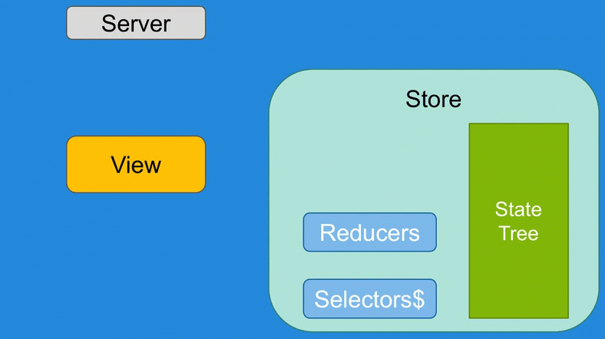
Ngrx Flow

Slide 154
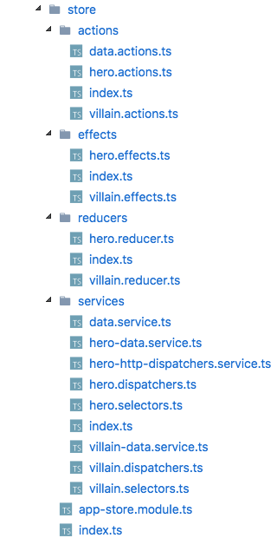
Ngrx demo
Store
Actions
Reducers
Dispatchers
Selectors
Effects
https://github.com/johnpapa/ngrx-demo
https://github.com/DanWahlin/angular-architecture/tree/master/state-management

Slide 155
Let’s Think This Through
Too much boilerplate?
Entities are the bulk of the work
Code generation isn’t the answer (now you have more problems)
What if you wrote NOTHING !?
1 line of code per entity
It is ngrx (just greatly simplified)
ngrx/data

Slide 156
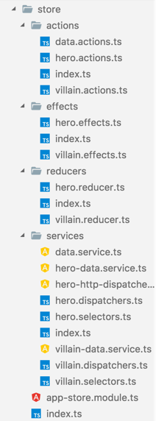
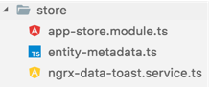
@ngrx
@ngrx/data

Slide 157
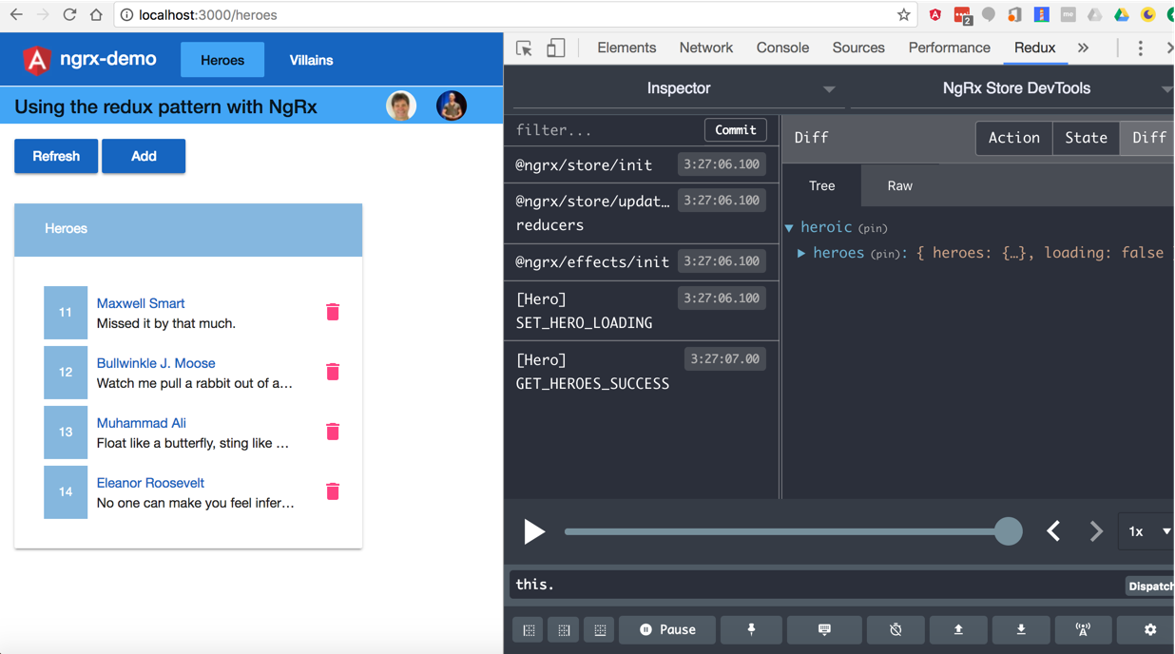

Slide 158
How to Grow into State Management?
Start here - Components never share data
Then go here - Services with Subjects/Observables
Then go to Observable Store
Then end up here - Ngrx (with @ngrx/data)

Slide 159
Slides https://jpapa.me/afa-1
Lab (Bonus) - Working with State Management
Choose your own adventure (pick from 1 of the following):
Working with NgRx
Working with ngrx-data
Working with Observable Store
https://codewithdan.me/angular-arc-labs

Slide 160
Thanks for Coming! @DanWahlin
@John_Papa
Slides: https://jpapa.me/afa-1 Demos: https://github.com/DanWahlin/angular-architecture
Labs: https://codewithdan.me/angular-arc-labs

